Slide 1
PDI Feather tracking
Weighting machine & label printer

Slide 2
Development environment setup
Prerequisite program
Git Bash
Bartender Software
MySQL v8.0.32, Visual Studio Code, Visual Studio 2022, Node.js
Good to have: Hercules

Slide 3
Development environment setup
Open PDI_Feather_Tracking_API
Build the project.
Open Package Manager Console and run command: Script-Migration
This command will generate sql script to do migration.
Open MySql Workbench.
Create a database, Name : feather_tracking
Open the script generated before, execute and the data should be seeded into the database.

Slide 4
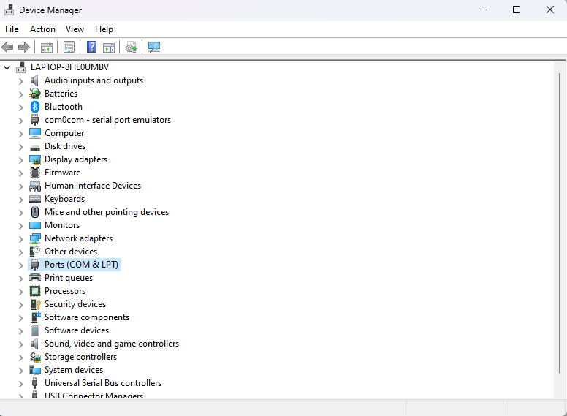
Program settings
Open PDI_FEATHER_TRACKING_WPF project, build the project as debug mode, search for appsettings.json.
Configure the printer name as the same shown in Windows printer utility.
Configure the Serial port connection properties of the weighting machine. The properties can be found in Device Manager > Ports

Slide 5
Program settings
Configure the label template path, logging path and report storage path.
Configure the database connection string to be the same as the database setup.
PrintService (0: disable, 1:enable)
WeightService (0:disable, 1:enable)
LogServicePort & PrintServicePort (change this if the port has been used for other purpose).
Program need to be restarted if the setting file has been changed.

Slide 6
PROGRAM SETTINGS

Slide 7
Pdi feather tracking wpf
WPF program should automatically run printer service if the path is set correctly.
Login screen will be prompted (default password : abc123)

Slide 8
Pdi feather tracking app/ service
Uses TCP connection to connect to WPF application process data.
Uses .NET Framework 4.7 (Seagull DLL limitation)
Handles printing service and logging service, references the settings file in WPF application.

Slide 9
PDI FEATHER TRACKING API
Act as database migration and web api.
Database migration uses Entity Framework Core Code First Approach.
Add-Migration MigrationName
Adds a new migration based on changes made on model classes and seeders
Update Database
Applies migration to database.
Remove-Migration
Remove last migration

Slide 10
Pdi feather tracking interface
VueJs progressive web application, vuex for token storage, fetch API.
Has to be run in https to get permission for using camera to scan QR, and for
Login user has to have permission for outbound.
Act both as mobile application and web application.

